Slide 1
Aakash Goel https://www.linkedin.com/in/goelaakash123/
Session 3:
Low Level Vision
Acknowledgement: Slide Materials adopted from - Intro to Computer Vision (Cornell Tech); Noah Snavely, prepared by the lead instructor Prof S P Vimal , modified (added some content) by Aakash Goel

Slide 2
Topics
Image Histogram & Histogram Equalization
Basic Intensity Transformations
Image Smoothing
Color Images; Color spaces: RGB and HSV
Acknowledgement: Slide Materials adopted from - Intro to Computer Vision (Cornell Tech); Noah Snavely

Slide 3
Image Histogram : What ?
An image histogram is a graph showing the distribution of pixel intensities in an image.
X-axis → intensity values (0 to 255 for 8-bit grayscale)
Y-axis → number of pixels having that intensity

Slide 4
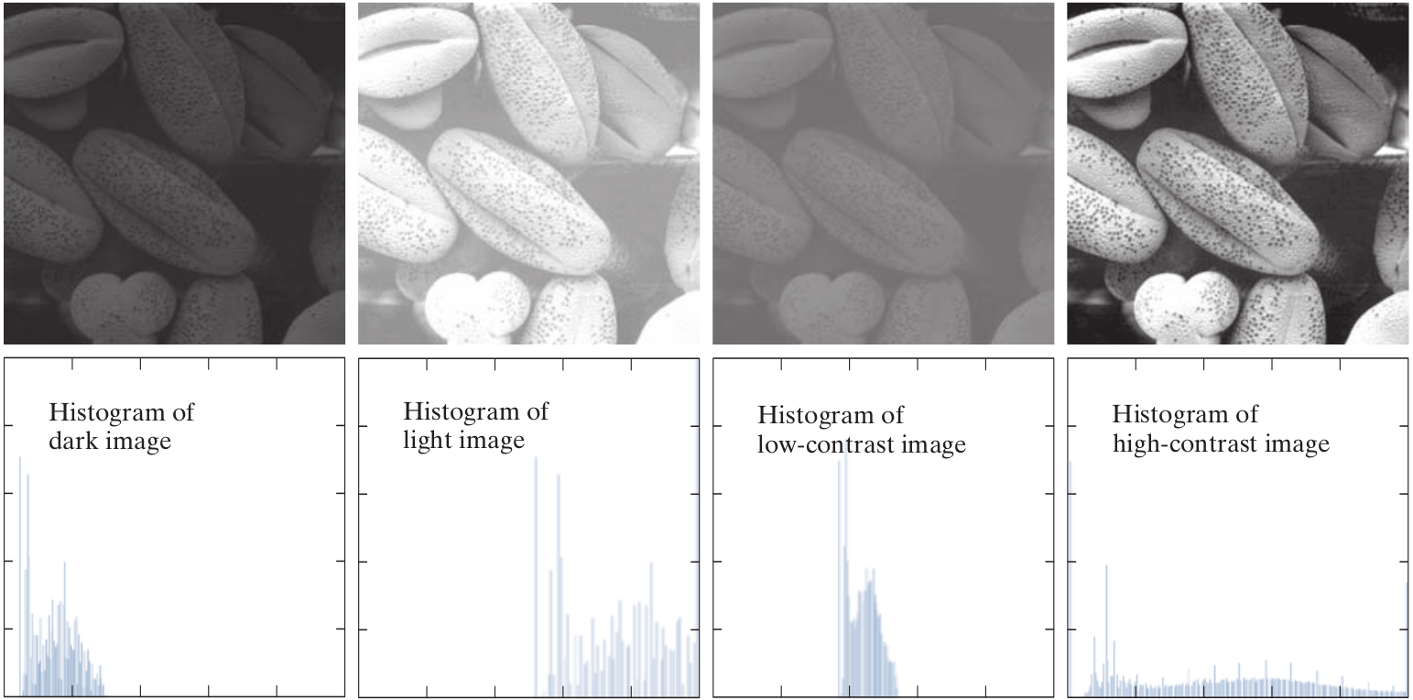
Image Histogram
Histogram shape is related to image appearance ;

Slide 5
Image Histogram : Why Important ?
It helps us:
Understand brightness/contrast of the image.
Detect whether the image is too dark (left-skewed), too bright (right-skewed), or low-contrast (narrow range).
Decide if enhancement (e.g., equalization) is needed.
📷 Real-world Analogy
Think of an image like a room of people and histogram as a bar chart of their heights.
If everyone is of similar height (flat histogram), it lacks contrast—like an image with dull tones.
If people range from short to tall (spread histogram), it's rich in variety—like a high-contrast image.

Slide 6
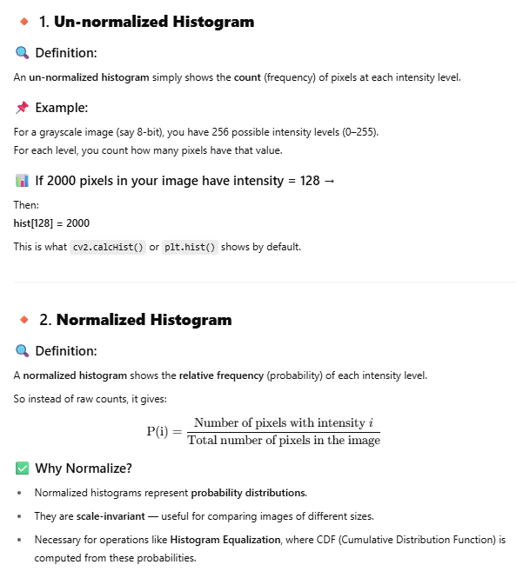
Image Histogram : Normalized Vs. Un-Normalized
Intensity | Count (Un-normalized) | P(i) (Normalized)
0 | 4 | 4 / 16 = 0.25
100 | 6 | 6 / 16 = 0.375
200 | 6 | 6 / 16 = 0.375
Type | What it shows | Use Case
Un-normalized | Absolute pixel counts | Basic visualization
Normalized | Probability of intensity | Contrast analysis, Histogram Equalization, ML input features

Slide 7
Histogram Equalization: What ?
It is a technique to redistribute pixel intensities to improve the contrast of an image.
In many real-world cases:
Images are too dark (e.g., taken at night).
Images are low-contrast due to fog, poor lighting, etc.
Equalization makes features more visible by spreading out the histogram.
⚙️ Real-world Analogy
Imagine redistributing wealth in a country:
Before equalization: few rich, many poor (intensity concentrated).
After equalization: more balanced wealth (intensity spread).

Slide 8
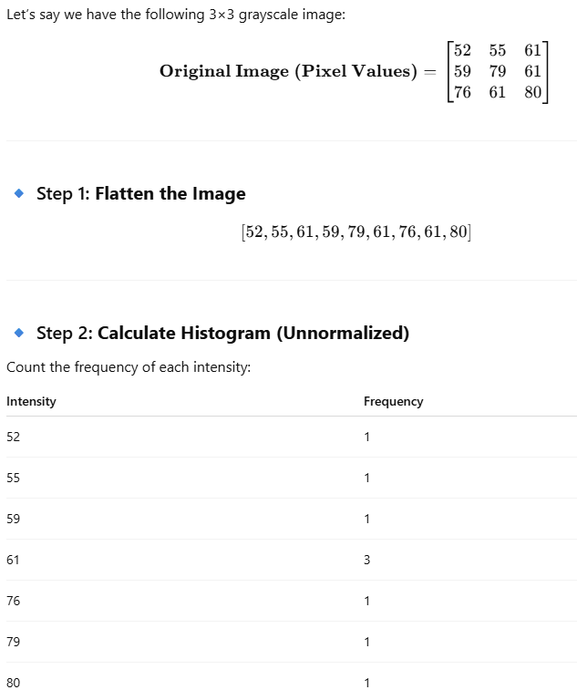
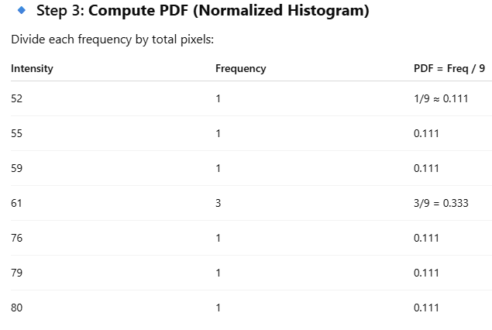
Histogram Equalization: How ?
CDF (Cumulative Distribution Function) of histogram is computed.
CDF is normalized and used to map old intensity values to new ones.
This mapping makes dark areas brighter and bright areas darker—resulting in contrast enhancement.

Slide 9
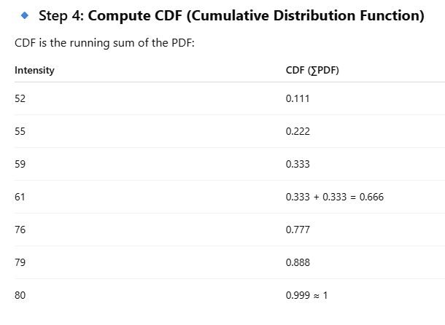
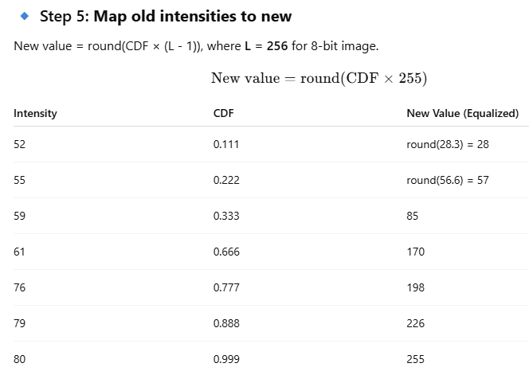
Histogram Equalization : How ?

Slide 10
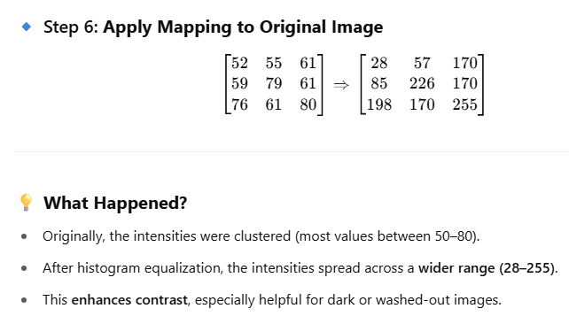
Histogram Equalization: How ?

Slide 11
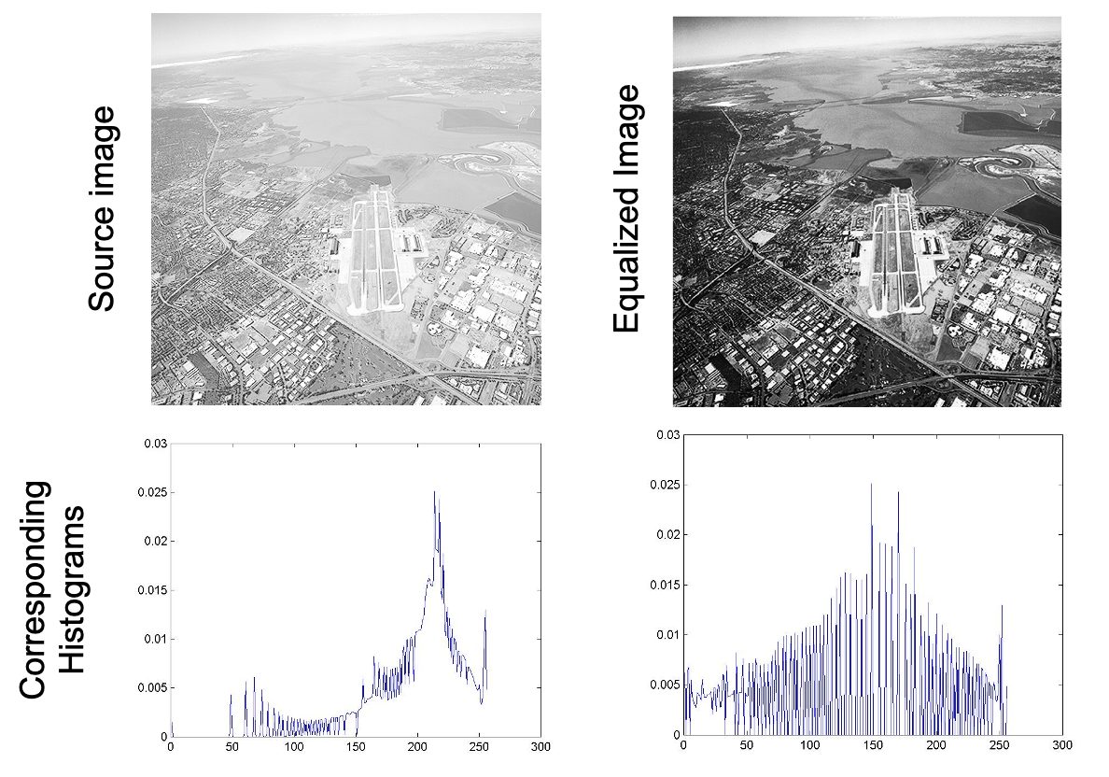
Histogram Equalization

Slide 12
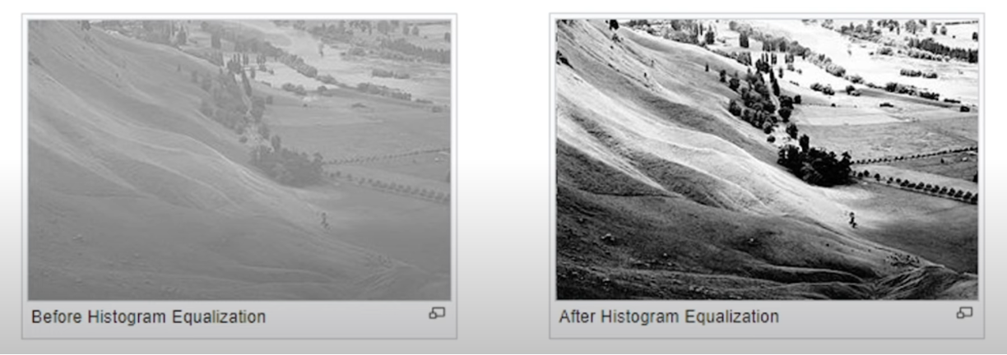
Histogram Equalization
Often images poorly use the full range of the gray scale
Solution:
Transform image such that its histogram is spread out more evenly in grayscale

Slide 13
Elementary Intensity Transformations in Image Processing
These are basic pixel-wise operations applied to each pixel’s intensity in an image. They're like mathematical functions that map input intensity values to output intensity values.
🔹 Why do we need them?
Enhance contrast
Brighten or darken an image
Suppress background
Highlight features
Prepare for segmentation or feature extraction

Slide 14
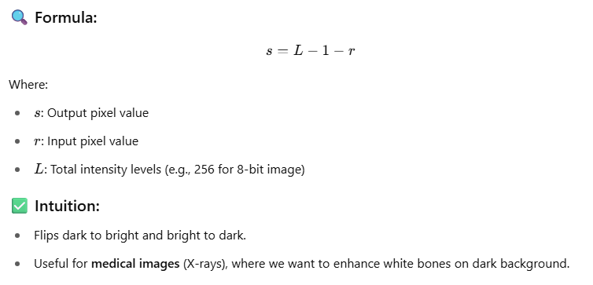
Image Negatives

Slide 15
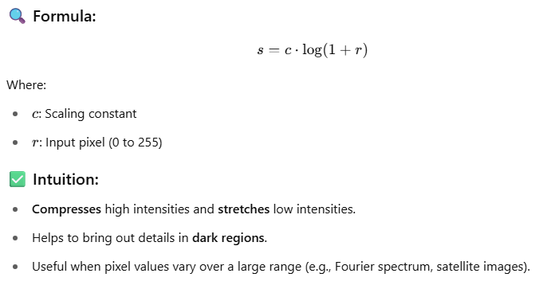
Log Transformations

Slide 16
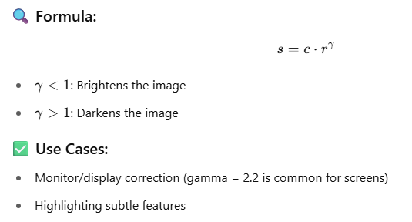
Power-Law (Gamma) Transformation

Slide 17
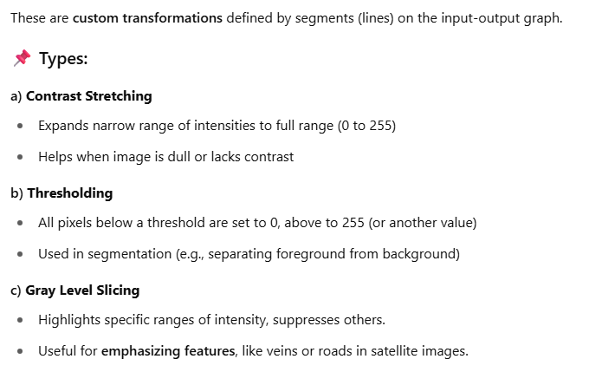













Piecewise Linear Transformations

Slide 18










































Slide 19
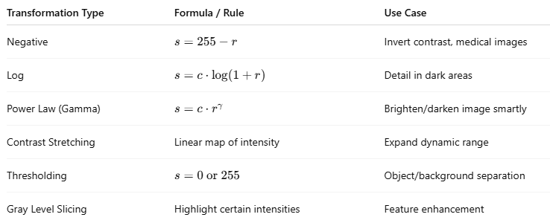
Image Transformation: Summary
💡 Real-World Example:
Let’s say you have a CCTV night image:
It’s dark → use log transformation to reveal hidden details.
After that, apply contrast stretching for better visual impact.

Slide 20
Image Smoothing: What ?
Image Smoothing refers to the technique of reducing noise and detail in an image by averaging pixel values with their neighbors. It's a form of low-pass filtering.

Slide 21
Image Smoothing: Why ?
Real-World Intuition:
Imagine a photo taken in low light—it often looks grainy (has noise).
Or a fingerprint image that needs to be pre-processed before feature extraction.
Before edge detection, segmentation, or object detection, we often apply smoothing to reduce irrelevant details.

Slide 22
Image Smoothing: Types
Technique | Description | Preserves Edges?
Average Blur | Replaces pixel with mean of neighbors | ❌ No
Gaussian Blur | Weighted average using a Gaussian kernel | ✅ Somewhat

Slide 23
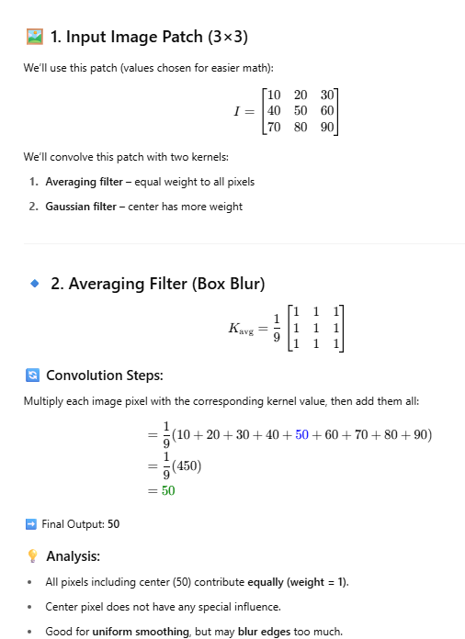
Averaging Filter

Slide 24
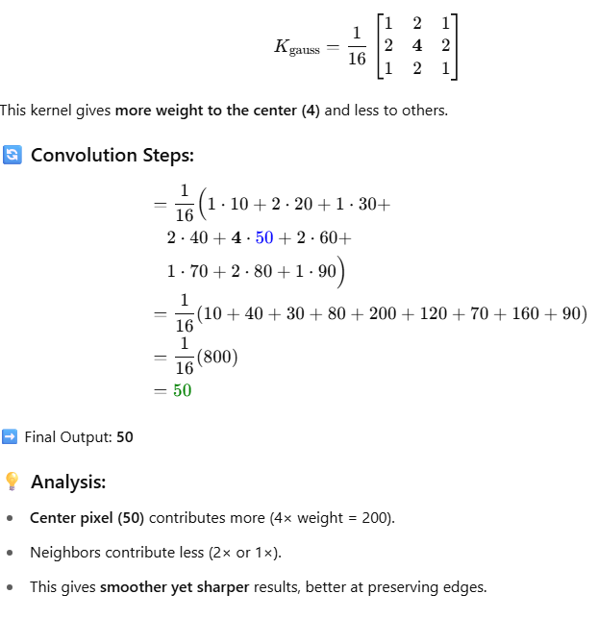
Gaussian Filter

Slide 25
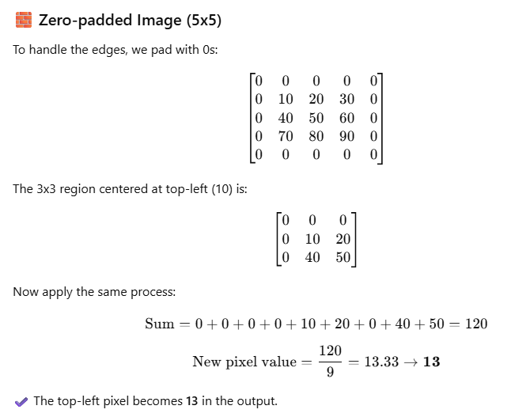
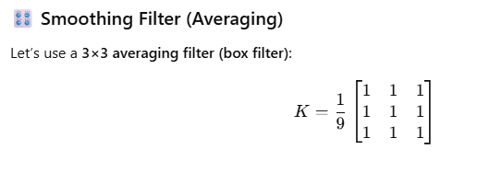













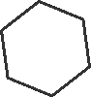



Padding

Slide 26
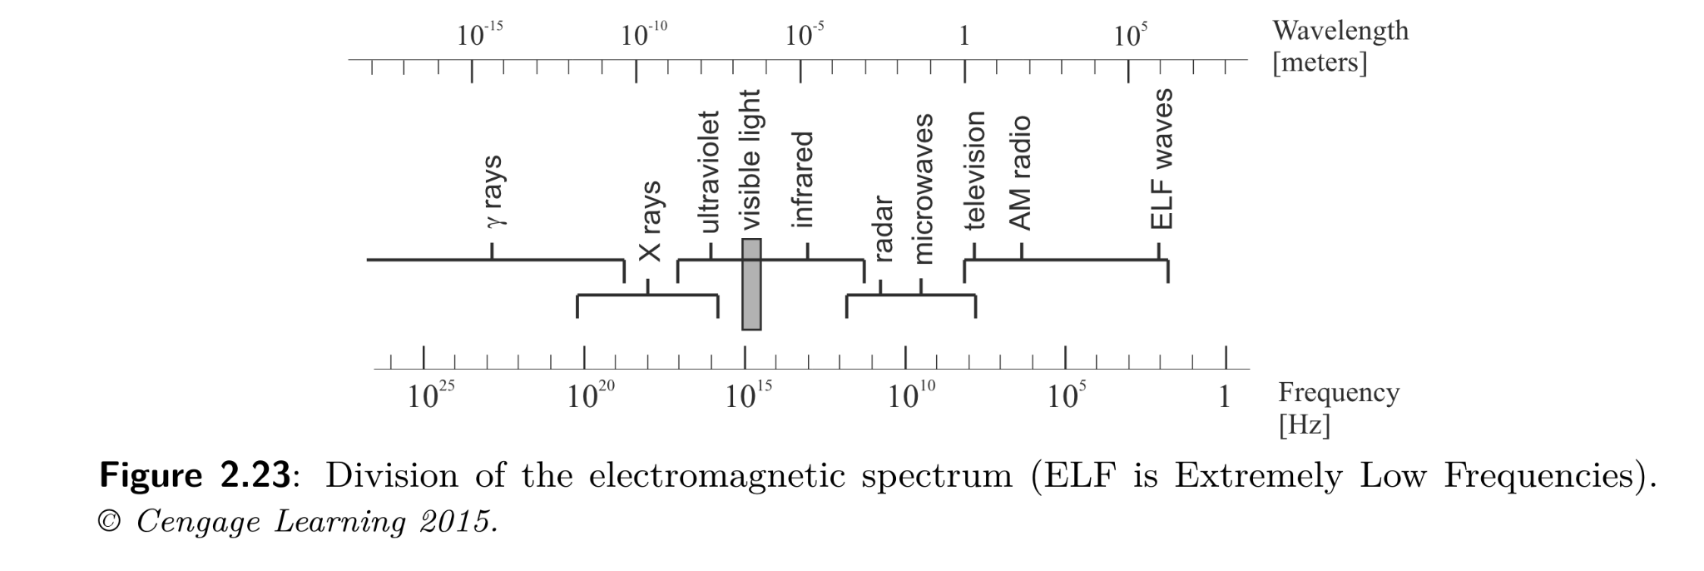
Color Images
Light is an electromagnetic wave

Slide 27









Color Image
A color image is composed of multiple channels — typically Red, Green, Blue (RGB).
Each pixel has three intensity values: one for each channel.
Together, they define the color at that pixel.
📌 Example:
A pixel in grayscale might be 128
A pixel in color might be (123, 85, 200) — Red=123, Green=85, Blue=200
Think of RGB like mixing paints:
Red + Green = Yellow
Red + Blue = Magenta
All = White
None = Black
[255, 0, 0] → Pure Red
[0, 255, 0] → Pure Green
[0, 0, 255] → Pure Blue
[255, 255, 255] → White
[0, 0, 0] → Black

Slide 28


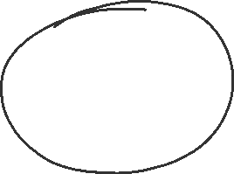









HSV : Hue-Saturation-Value
Hue = actual color (0–360 degrees)
Saturation = how pure the color is
Value = brightness
🧠 Analogy:
HSV is like picking color in a paint app:
Hue is the color wheel
Saturation is the slider for gray-to-pure
Value is how bright or dark the color is
HSV's real benefit is not in display but in color filtering, thresholding, and segmentation, especially for things like detecting a specific color.
HSV separates the concept of color (Hue), vibrancy (Saturation), and brightness (Value).
HSV is more aligned to how humans perceive colors, which is helpful for tasks like:
Detecting a red ball (by filtering hue)
Enhancing low-light images (by modifying value)

Slide 29




Hue in HSV directly represents color — and red is at the ends of the Hue scale (around 0° and 180°).
HSV Range: [H, S, V]
Hue: 0–179 in OpenCV (not 0–360!)
Saturation: 0–255 (how vibrant)
Value: 0–255 (brightness)
Red wraps around the HSV hue wheel. So in OpenCV:
Some red tones are near 0–10
Others are near 160–180
Real Hue (Degrees) | OpenCV Hue Value
0° (Red) | 0
360° (Red again) | 179
[0, 100, 100] = Red hue, medium saturation, medium brightness [10, 255, 255] = Red-orange hue, very vibrant and very bright
✅ Lower Bound: [0, 100, 100]
Minimum Hue: 0 → red starts here
Minimum Saturation: 100 → filters out dull, grayish tones
Minimum Value: 100 → filters out very dark pixels
✅ Upper Bound: [10, 255, 255]
Maximum Hue: 10 → includes red to reddish-orange
Max Saturation & Brightness: 255 → allow all vivid/bright pixels

Slide 30
Component | Meaning | Range | Analogy
Hue (H) | Color type (e.g., red, blue) | 0–360° (in OpenCV: 0–179) | Think of a color wheel
Saturation (S) | Color intensity (0 → gray, 100% → pure color) | 0–100% (OpenCV: 0–255) | Like color richness
Value (V) | Brightness (0 → black, 100% → full bright) | 0–100% (OpenCV: 0–255) | Like light or shade of the color
Task | RGB | HSV
Adjusting brightness | All channels must change | Change just V
Finding red/yellow color | Complex in RGB | Just check H range
Image segmentation | Hard in RGB | Easy in HSV

Slide 31
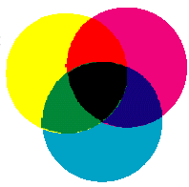
Cyan-Magenta-Yellow
• Used internally in color printers
• Subtractive
• Complementary to RGB:
•C=1-R
•M=1-G
•Y=1-B
• Also CMYK (blacK)
– mostly for printer use

Slide 32
CMYK
• K is for blacK
• Save on color inks, by using black ink preferably
• K = min(C,M,Y)
• C = C-K
• M = M-K
• Y = Y-K

Slide 33
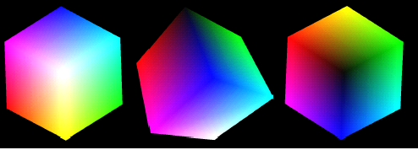
The RGB color cube
https://chromatone.center/theory/color/models/

Slide 34
The HSI Color Model
RGB, CMY, and the like are hardware-oriented color spaces
(suited for image acquisition and display)
The HSI (Hue, Saturation, Intensity) is a perceptive color space
(suited for image description and interpretation)
It allows the decoupling of chromatic signals (H+S) from the intensity signal (I)

Slide 35
Brightness, Hue, and Saturation
Brightness is a synonym of intensity
Hue represents the impression related to the
dominant wavelength of the color stimulus
Saturation expresses the relative color
purity (amount of white light in the color)
Hue and Saturation taken together are called
the chromaticity coordinates (polar system)
Matlab conversion function: rgb2hsv

Slide 36
Readings:
Digital Image Processing, Rafael C. Gonzalez & Richard E woods, Third Ed, Chapter 3
Next Class:
Image Sharpening; Linear Filters; Edge Detection using Gradients, Sobel,Canny; Demonstration of Applications in Python
Line detection using Hough transforms; [ if possible]

Slide 37
Thank you

